Slide 1
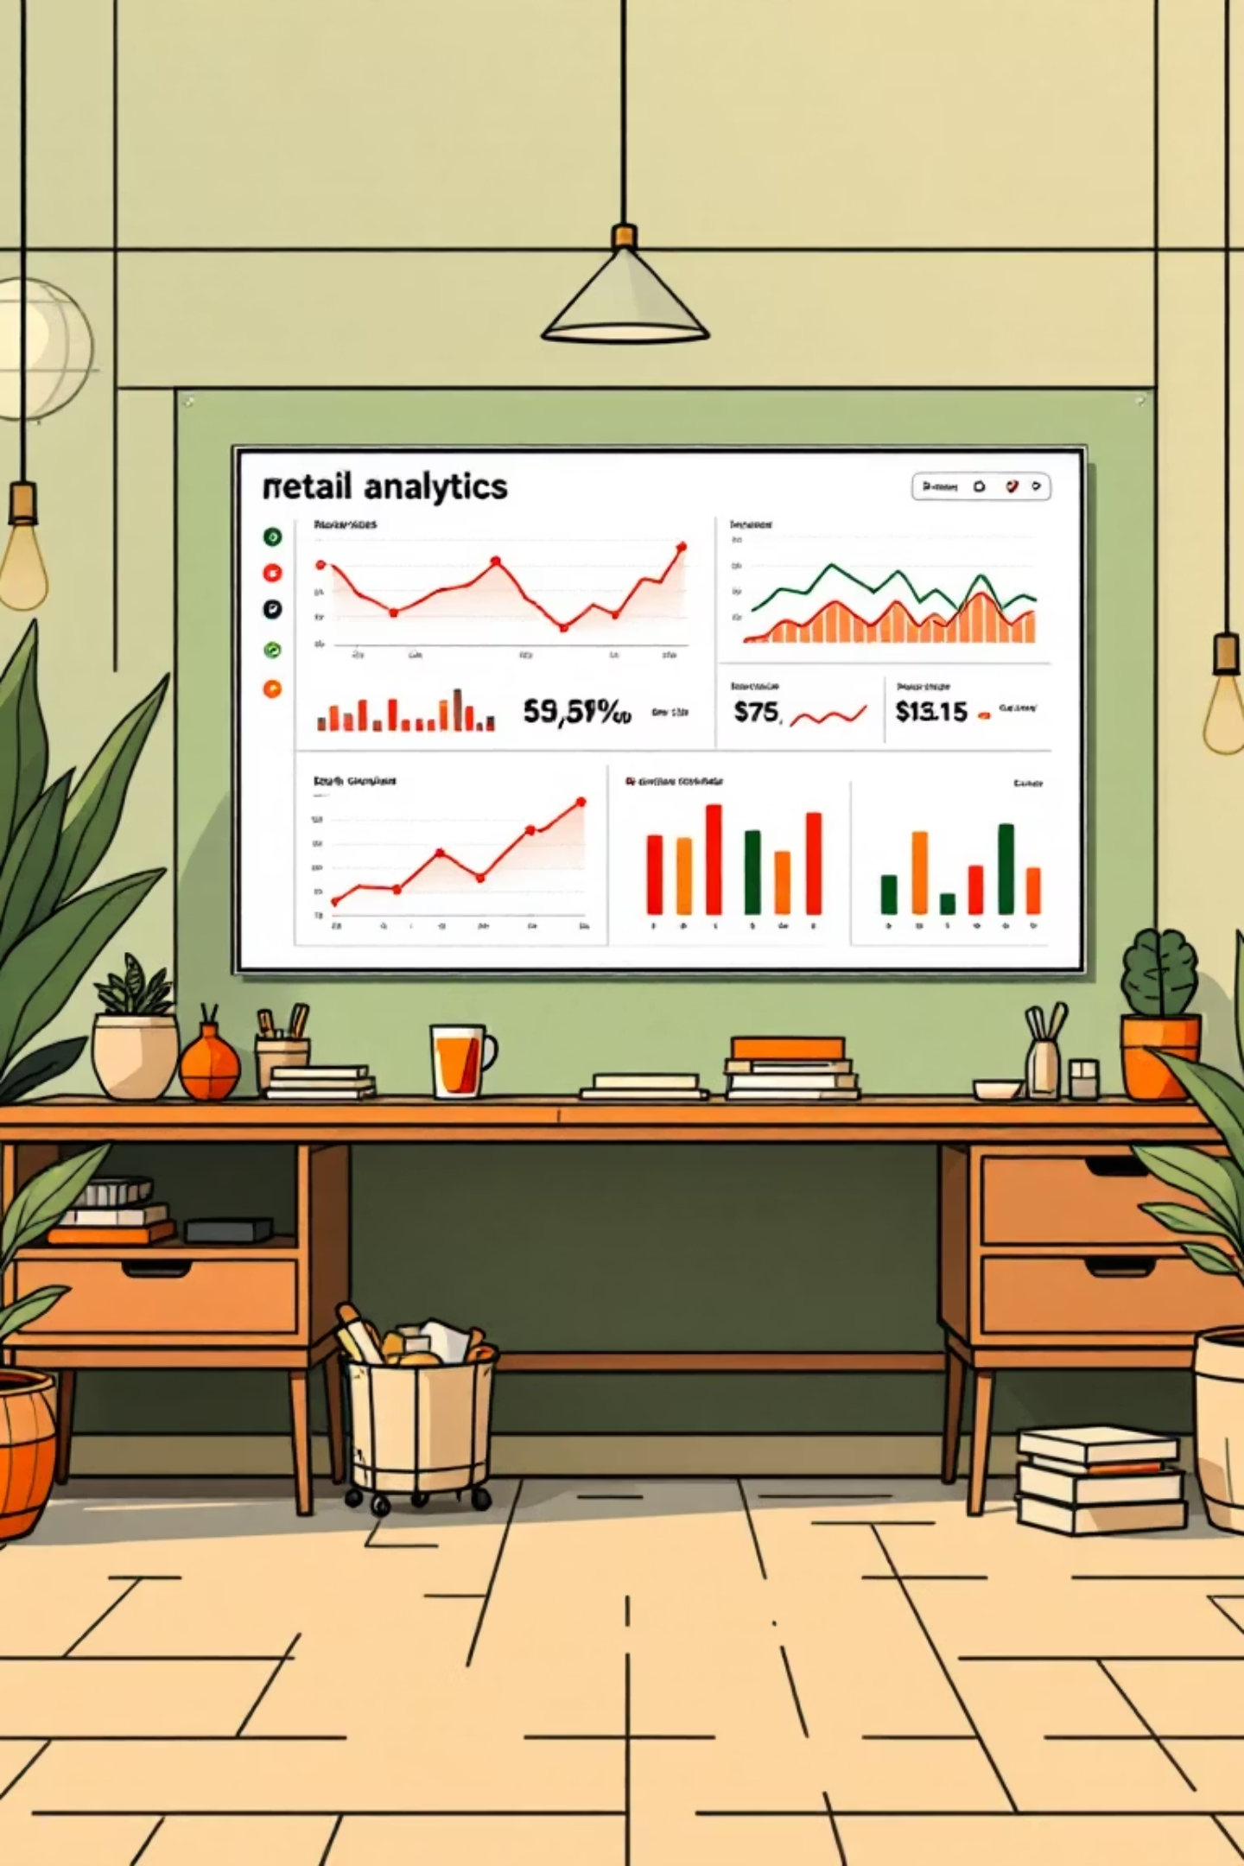
Customer Shopping Behaviour Analysis
Uncovering insights from 3,900 purchases to guide strategic business decisions through data-driven analysis of spending patterns, customer segments, and product preferences.

Slide 2
PROJECT SCOPE
Data at a Glance
3,900
18
50
25
Total Purchases
Data Features
Locations
Product Types
Transactions analyzed across various product categories
Comprehensive attributes covering demographics and behavior
Geographic diversity across customer base
Wide variety of items purchased
Key data dimensions include customer demographics, purchase details, shopping behavior patterns, and subscription status—providing a 360-degree view of customer activity.

Slide 3






PYTHON ANALYSIS
Data Preparation Pipeline
Data Loading
Imported transactional data and performed initial structure checks
Exploration
Used df.info() and .describe() for summary statistics
Cleaning
Handled 37 missing values in Review Rating using median imputation
Engineering
Created age groups and purchase frequency features

Slide 4

Data Summary Statistics
Customer Demographics
Age range: 18-70 years (mean: 44 years)
Gender split: 2,652 male customers
Subscription tracking included
Purchase Patterns
Amount range: $20-$100 (mean: $59.76)
4 product categories analyzed
Clothing most popular (1,737 purchases)
Column standardization to snake case improved readability. Redundant promo_code_used column was dropped after consistency verification with discount_applied.

Slide 5

SQL
Business Questions Analyzed
1
2
Revenue by Gender
High-Spending Discount Users
Compared total revenue generated by male vs. female customers
Identified customers using discounts but spending above average
3
4
Top-Rated Products
Shipping Analysis
Found 5 products with highest average review ratings
Compared purchase amounts between Standard and Express shipping

Slide 6
Advanced SQL Insights
Subscriber Value
Discount Dependency
Customer Segmentation
Compared average spend and total revenue across subscription status to identify premium customer segments
Identified 5 products with highest percentage of discounted purchases for pricing strategy
Classified customers into New, Returning, and Loyal segments based on purchase history
Additional analysis revealed top 3 products per category, providing actionable insights for inventory and marketing optimization.

Slide 7
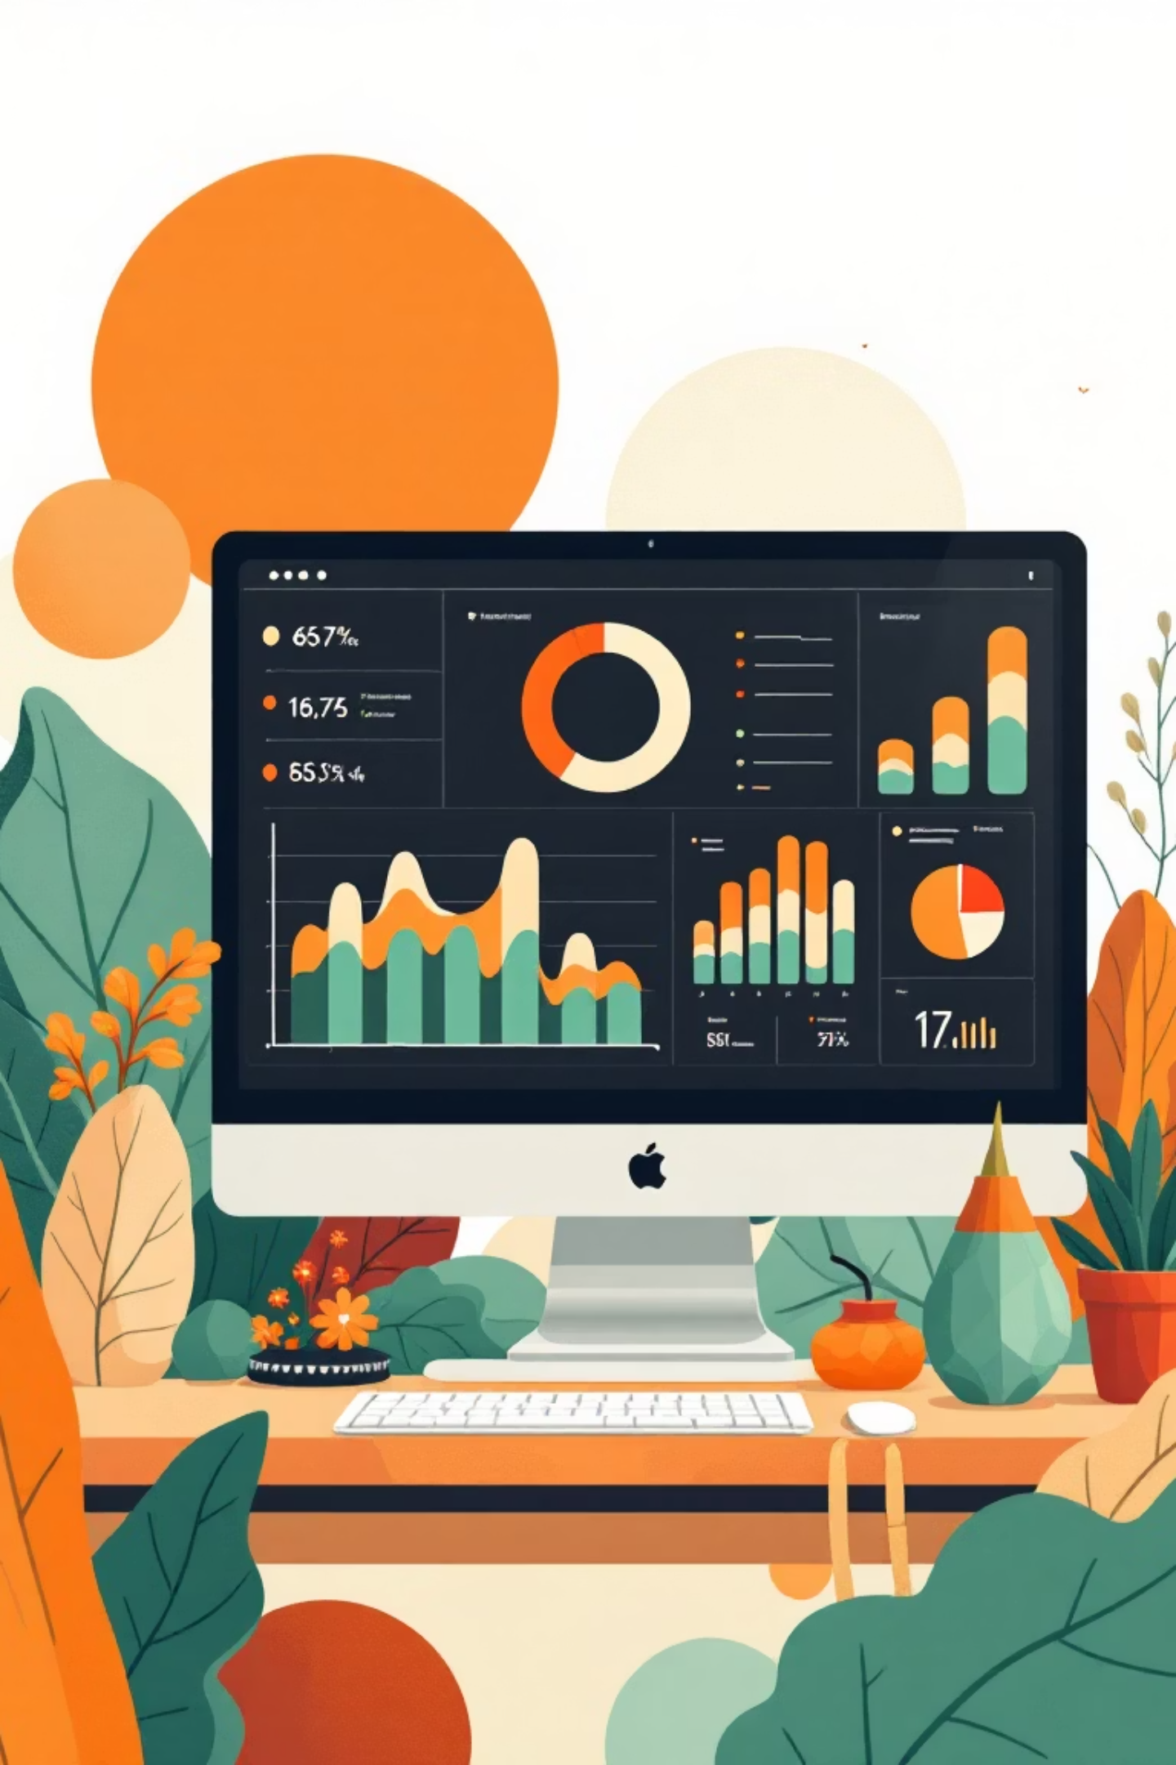
VISUALIZATION
Power BI Dashboard
Interactive dashboard consolidates all findings into a single view, enabling stakeholders to explore customer behavior patterns, revenue trends, and product performance metrics dynamically.

Slide 8
STRATEGIC ACTIONS
Business Recommendations
Boost Subscriptions
Loyalty Programs
Review Discount Policy
Promote exclusive benefits to convert more customers into subscribers
Reward repeat buyers to move them into the "Loyal" segment
Balance sales boosts with margin control for sustainable growth

Slide 9
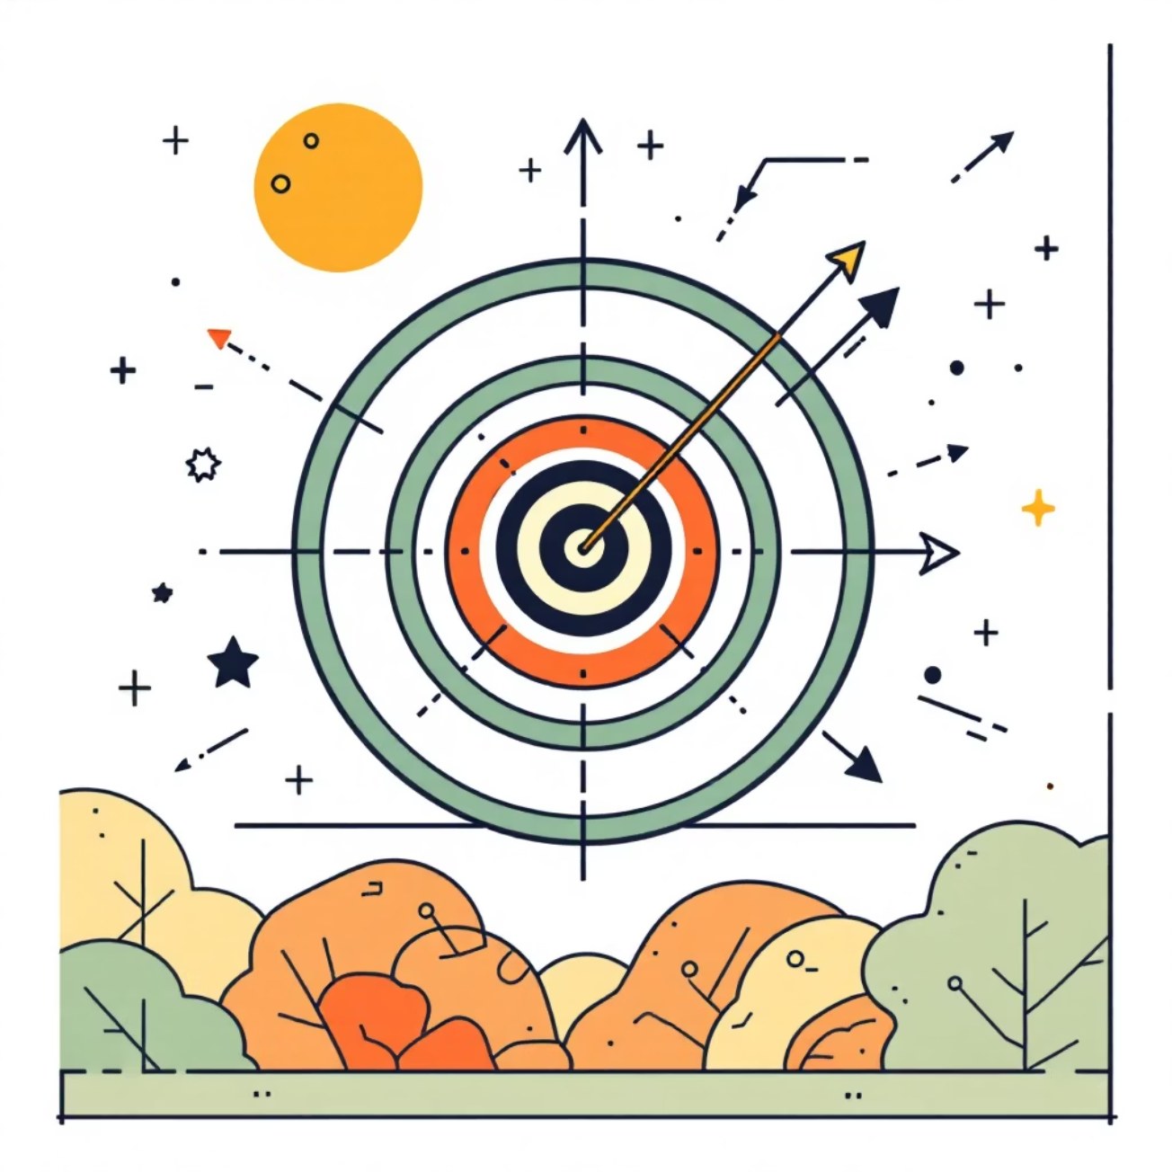
Marketing & Product Strategy
Product Positioning
Highlight top-rated and best-selling products in marketing campaigns
Targeted Marketing
Focus efforts on high-revenue age groups and express-shipping users
Strategic focus on customer segments with highest lifetime value will maximize ROI and drive sustainable revenue growth.

Slide 10




Key Takeaways
Data-Driven Insights
Customer Segmentation
Comprehensive analysis of 3,900 transactions reveals actionable patterns
Clear classification enables targeted retention and acquisition strategies
Revenue Optimization
Strategic Direction
Subscription and loyalty programs offer significant growth opportunities
Recommendations provide clear roadmap for business improvement

